Slide 1

Shri Vaishnav Vidyapeeth Vishwavidyalaya

Slide 2
General Disease Prediction System
Guided to
Aakash Jain (18100BTCSAII02825) Aman Rao Sanas (18100BTCSAII02830) Atharv Sharma (18100BTCSAII02834)
Guided By
Mr. Gaurav Thulla Sir

Slide 3
Problem Statement
The general disease prediction system predicts chance of presence of a disease present in a patient on the basis of their symptoms.
Due to big data progress in biomedical and healthcare communities, accurate study of medical data benefits early disease recognition, patient care and community services.
When the quality of medical data is incomplete the exactness of study is reduced. Moreover, different regions exhibit unique appearances of certain regional diseases, which may results in weakening the prediction of disease outbreaks.
In the proposed system, it provides machine learning algorithms for effective prediction of various disease occurrences in disease-frequent societies. It experiment the altered estimate models over real-life hospital data collected.
To overcome the difficulty of incomplete data, it use a latent factor model to rebuild the missing data. It experiment on a regional chronic illness of cerebral infarction. Using structured and unstructured data from hospital it use Machine Learning Decision Tree algorithm and Map Reduce algorithm.
To the best of our knowledge in the area of medical big data analytics none of the existing work focused on both data types.

Slide 4
Data Description
Data sets will be take from Kaggle for prediction the disease
The predictive model predicts the disease a person might have based on the user entered symptoms.
Input from users
(patients)
Machine Learning algorithm
Data Sets
R Tools
Predicted Output

Slide 5
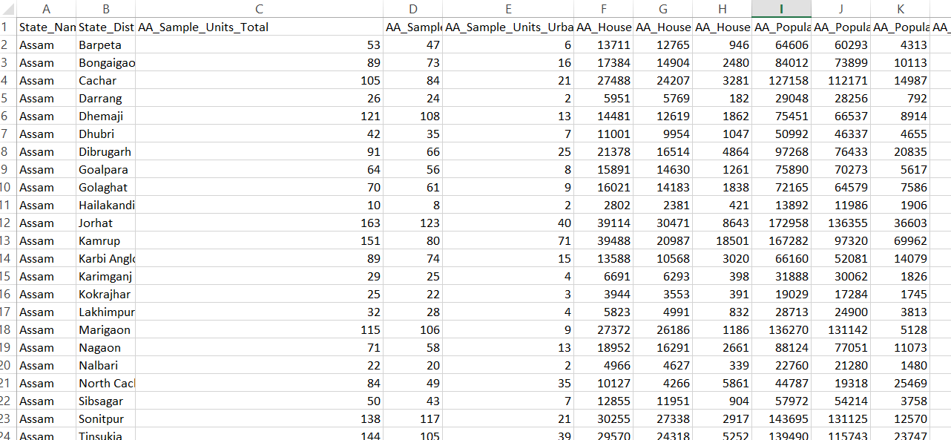
The data set obtained in this study was obtained from several regions.

Slide 6
Technology used in the project
Applied Machine Learning
ML is being used for the inquiry of the wild of controlled edges and their mixtures for forecast, e.g. forecast of illness development, removal of medicinal information for consequence investigation, treatment guidance and provision, and for the overall enduring organization.
It is contended that the successful presentation of ML attitudes can help the tally of computer-based structures in the healthcare setting providing chances to ease and enhance the exertion of medical boffins and eventually to recover the competence and excellence of medicinal repair.
ML requests in Health Sector. Machine Learning learns the data and produces the result
Software used for implementation
We are going to use R language in this project for the analysis of data and predicting the disease on the basis of symptoms

Slide 7
Outcomes and Future Prospects
India is the second most populated country in the world with over 1.3 Bn people. The growing population has significantly increased the demands for basic amenities such as food, clothing, shelter, jobs, and healthcare.
While deep technology penetration has definitely improved the quality of the healthcare industry, the opportunities are not equally available to the entire country due to increased population.
In India, there is one allopathic government doctor for every 10,189 people, one government hospital bed for every 2,046 people and one state run hospital for every 90,343 people.
The system describe the prediction of disease based on symptom’s dataset which is provide by the patient of different region.
The current system covers only the general diseases or the more commonly occurring disease.
The project is to include disease of higher fatality, so that early prediction and treatment could be done, and the fatality rate of deadly diseases like cancer decreases, with the economic benefit in long sight as well.

Slide 8
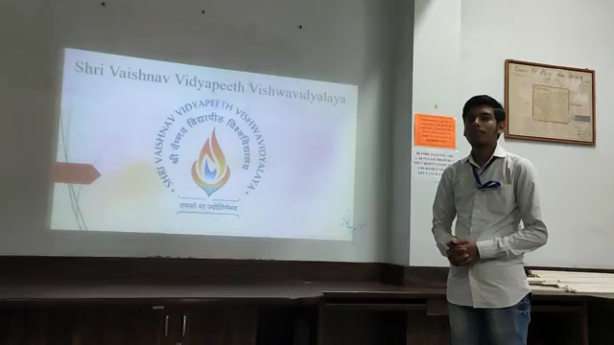
Video

Slide 9
Thank you

